Slide 1
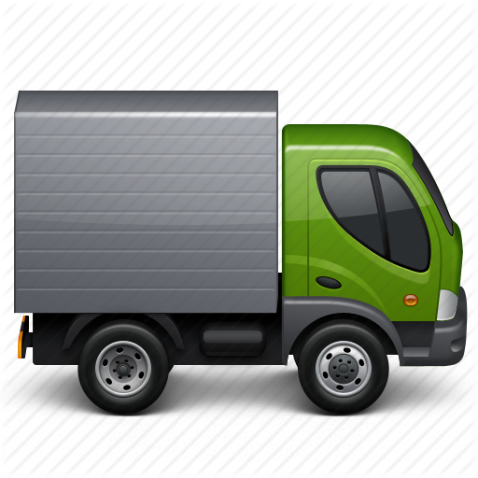


IAS 16: PROPERTY, PLANT AND EQUIPMENT

Slide 2
OBJECTIVE & SCOPE
OBJECTIVE: Accounting treatment of PPE (.2)
Recognition of asset
Determination of carrying amount
Depreciation and impairment losses (Impairment losses = IAS 36)

Slide 3
OBJECTIVE & SCOPE
SCOPE (.3) Excludes:
PPE classified as held for sale – IFRS 5 (FA379)
Biological assets - IAS 41
Mineral rights and exploration – IFRS 6
Investment property - IAS 40 (FA278)
Includes:
PPE used to develop or maintain biological assets and development of mineral rights and exploration
Assets used in finance lease (FA379)

Slide 4
PART I
Classification (in accordance with definitions) and recognition
Initial measurement: Determining cost price
Measurement after initial recognition: cost model and depreciation
Measurement after initial recognition: revaluation model

Slide 5
RECOGNITION
(.6) PPE are tangible items that
Are held for use in
The production or supply of goods or services;
rental to others; or
admin purposes;
AND
Expected to use for more than one period
(.7) The cost shall be recognized as an asset if, and only if:
Probable that future econ benefits associated with item will flow to entity
Cost of item can be measured reliably

Slide 6
RECOGNITION
(.8) Items such as spare parts are recognised in terms of IAS 16 if it meets the definition of Property, plant and equipment. Otherwise classified as inventory.
Question 1

Slide 7

INITIAL MEASUREMENT: DETERMINING COST PRICE (.15-.28)
(.15) If item qualifies for recognition, then the asset shall be measured at COST
(.6) Definition of Cost
Cash or cash equivalents paid, or
fair value of other consideration given to acquire the asset at time of acquisition or construction, or
Where applicable, the amount attributed to that asset in accordance with the requirements of other IFRSs (i.e. IFRS 2)

Slide 8
INITIAL MEASUREMENT: DETERMINING COST PRICE (.15-.28)
(.16) Elements of cost include:
Purchase price, import duties, non-refundable purchases taxes, deducting discounts / rebates
Directly attributable costs bringing the asset to the location & condition to be capable of operating
Initial estimate of costs of dismantling / removing the item and restoring the site on which it is located (Hons)

Slide 9
INITIAL MEASUREMENT: DETERMINING COST PRICE (.15-.28)
(.17) Examples of directly attributable costs:
cost of employee benefits arising directly from construction/acquisition of the item of PPE
cost of site preparation
initial delivery and handling costs
installation and assembly costs
costs of testing whether the asset is functioning properly; and
professional fees

Slide 10
INITIAL MEASUREMENT: DETERMINING COST PRICE (.15-.28)
(.19) Costs which are excluded:
opening a new facility;
introducing new products / services (advertising / promotional costs)
conducting business in a new location / new class of customer (incl cost of staff training)
admin and general overheads

Slide 11
INITIAL MEASUREMENT: DETERMINING COST PRICE (.15-.28)
(.20) Capitalisation of costs ceases when the item is in location / condition necessary for it to be capable of operating in manner as intended by management
(.20) Thus, costs incurred to use or in redeploying asset not included in cost price, e.g.:
costs incurred with regards to item already capable of operating in manner intended, but has not been used or is used at less than full capacity
initial operating losses
costs of relocating or reorganizing the entity’s operations
Note: par 20A:
Items produced while bringing an item of PPE to the location and condition necessary for it to be capable of operating in the manner intended by management (such as samples produced when testing whether the asset is functioning properly). An entity recognises the proceeds from selling any such items, and the cost of those items, in profit or loss in accordance with applicable Standards. The entity measures the cost of those items applying the measurement requirements of IAS 2.

Slide 12
INITIAL MEASUREMENT: DETERMINING COST PRICE (.15-.28)
(.21) Incidental income/ expenses
Related to development of asset, but not necessary to get asset in condition & location to be capable of operating in manner intended
Example: Earn income by using premises as parking lot, before building is constructed
incidental income / expenses not included in cost of asset = Profit/loss

Slide 13
INITIAL MEASUREMENT: DETERMINING COST PRICE (.15-.28)
(.21) Self-constructed assets
Cost determined using the same principles as for acquired asset
Excluded from cost:
internal profits (e.g. between branches & divisions), and
abnormal amounts (e.g. unnecessary material and labour used)
Deferred payments (FA278)
Example 1a + 1b

Slide 14

MEASUREMENT AFTER INITIAL RECOGNITION
(.29) Entity chooses one model
Disclose choice in accounting policy
Model is applied to entire class of assets
Carrying amount
SFP-amount after deducting accumulated depr and accumulated impairment losses
Choice
Cost model (.30 & .43 - .62) or
Revaluation model (.31 – .42)

Slide 15
MEASUREMENT AFTER INITIAL RECOGNITION: Cost model
(.30) COST MODEL:
After recognition as an asset, the item of PPE will be recorded at:
Cost Less accumulated depreciation Less accumulated impairment (FA278)

Slide 16
DEFINITIONS (.6)
Depreciation
Systematic allocation of the depreciable amount over the useful life of an asset
Depreciable amount
Cost less residual amount
Useful life
Period over which an asset is expected to be available for use by an entity, or
number of production or similar units expected to be obtained from the asset by the entity

Slide 17
DEFINITIONS (.6)
Residual value
Estimated amount that an entity would currently obtain form disposal of the asset,
After deducting the estimated costs of disposal,
If the asset were already of the age / condition expected at end of useful life

Slide 18
MEASUREMENT AFTER INITIAL RECOGNITION: Cost model
(.44 – .50): Depreciation
(.48) Depreciation recognised as expense, unless part of the carrying amount of other assets
(.50) Depreciable amount shall be allocated on systematic basis over useful life

Slide 19
MEASUREMENT AFTER INITIAL RECOGNITION: Cost model
(.51) Residual value & useful life must be reviewed at least at end of each financial year-end. (Changes treated according to IAS 8, FA 379)
(.53)Depreciable amount is after deduction of residual value (residual value most of the time insignificant)
(.52) Depreciate even though fair value > carrying amount
(.52) Stop depreciation if residual amount > carrying amount irrespective of repairs still required

Slide 20
MEASUREMENT AFTER INITIAL RECOGNITION: Cost model
(.55) Depreciation starts
from date when asset is available for use,
in location and condition, as intended by management.
Depreciation stops
Earliest of:
Decision to reclassify as held for sale (IFRS 5); or
Asset is derecognised

Slide 21
MEASUREMENT AFTER INITIAL RECOGNITION: Cost model
(.56) Factors considered in determining the depreciation / useful life:
Expected usage of asset (capacity or physical output)
Physical wear and tear (shifts, repair and maintenance programme in place)
Technical or commercial obsolescence
Legal limitations on use of the asset (expiry dates or lease agreements)

Slide 22
MEASUREMENT AFTER INITIAL RECOGNITION: Cost model
(.57) Determination of useful life: use judgment based on experience of entity with similar assets
Useful life can be less than the economic life as useful life depends on period that entity wants to use asset

Slide 23
MEASUREMENT AFTER INITIAL RECOGNITION: Cost model
(.58) Land and buildings treated separately:
Land:
Unlimited useful life; thus not depreciated,
Exceptions: quarries, mines
Buildings: limited useful life, thus depreciate
(.59) If dismantling costs are included in the cost of land, depreciate this amount over period that entity will receive benefits [Hons]

Slide 24
MEASUREMENT AFTER INITIAL RECOGNITION: Cost model
(.60-.62) DEPRECIATION METHOD
Depreciation method shall reflect pattern in which the asset’s future economic benefits are expected to be consumed
Revise at least annually
Apply consequently, unless significant change
In case of significant change in method (use IAS 8 change in estimates – FinAcc 278)
(.63 - .66) IMPAIRMENT (FA278)

Slide 25
MEASUREMENT AFTER INITIAL RECOGNITION: Cost model
DEPRECIATION METHOD (cont.)
Available methods:
Straight line (consistent amount)
Diminishing balance (decreasing amount)
Units produced (based on output)

Slide 26
DEPRECIATION
Asset is used for > 1 period
as asset is used its value decreases
an asset has an estimated useful life
Use the “convenience account” accumulated depreciation and do not write depreciation off directly against the cost account

Slide 27
DEPRECIATION METHODS
1. Fixed instalment (straight-line method)
Depr = fixed amount calculated on fixed % of depreciable amount over useful life of asset from date asset is ready for use
NB! If asset is brought into use or alienated during the year, depreciation is apportioned for that period
Example 2

Slide 28
DEPRECIATION METHODS
2. Diminishing balance method (reducing balance method)
write off on (depreciable amount – accumulated depr) at a fixed % from date ready for use
NB! If asset is brought into use or alienated during the year, depreciation is apportioned for that period
Example 3

Slide 29
DEPRECIATION METHODS
3. Production unit method
Life of asset based on total number of units that an asset can produce
Depr for year = depreciable amount x units produced during the year divided by the total estimated units that will be produced by the asset
NB! Asset in use for only a portion of the year – no apportionment needed
Variation
use machine hours
use kilometers
Example 4
What about the period from when the asset is ready for use to beginning of use?

Slide 30
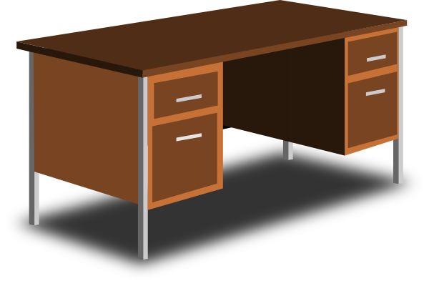
DERECOGNITION (.67 – .72)
(.67) Derecognise the carrying amount if:
Asset is disposed of
No further econ benefits are expected from the use or disposal of the asset

Slide 31
DERECOGNITION (.67 – .72)
(.68) Profit / loss with derecognition to be recognised in SCI.
Profit / loss = net proceeds with sale less carrying amount
Example 7+8

Slide 32
DISCLOSURE (.73 - .79)
IAS16:73(a) | The measurement basis used for determining the gross carrying amount of the property, plant and equipment.
IAS16:73(b– c) | The depreciation method, depreciation rate and useful lives used
IAS16:73(d) | Gross carrying amount and accumulated depreciation at the beginning and end of the year
IAS16:73(e) | Reconciliation of the carrying amount from beginning to end of the year showing additions, disposals, revaluations, depreciation and any other movements.
IAS16:74(a) | Restrictions on title or whether asset is pledged as security
IAS16:74(d) | Any compensation received for assets that were disposed of or written-off during the year
IAS1:97 | Profit or loss on sale of property, plant and equipment (usually considered to be qualitatively material)

Slide 33
MEASURMENT AFTER INITIAL RECOGNITION
Initial recognition
COST PRICE
Subsequent measurement
COST MODEL
REVALUATION MODEL
(.29) Entity choose cost – or revaluation model
(.30) Cost model: Carrying amount = Cost less accumulated depreciation and accumulated impairment losses
(.31) Revaluation model: Carrying amount = Revalued amount (fair value at date of revaluation) less subsequent accumulated depreciation and subsequent accumulated impairment losses

Slide 34

MEASUREMENT AFTER INITIAL RECOGNITION: Revaluation model
(.31) Can only revalue if fair value can be measured reliably.
(.6) Definition of Fair value
Price that would be received to sell an asset (or paid to transfer a liability) in an orderly transaction between market participants at the measurement date.
(.31) Revaluation must be performed on a regular basis to ensure that the carrying amount does not differ materially from the fair value at reporting date.

Slide 35
MEASUREMENT AFTER INITIAL RECOGNITION: Revaluation model
(.39) If carrying amount of asset increases because of revaluation
Cr Other comprehensive income in SCI (and accumulate in revaluation surplus in equity);
(.40) If carrying amount of asset decreases because of revaluation
Dr Other comprehensive income (in SCI) to the extent of any credit balance remaining in the revaluation surplus.
Example 9

Slide 36
DISCLOSURE (.73 - .79)
If items of property, plant and equipment are carried at revalued amounts:
IAS16:77(a) | The effective date of the revaluation
IAS16:77(b) | Whether an independent valuer was involved
IAS16:77(e) | The carrying amount if the asset had been carried at depreciated historic cost
IAS16:77(f) | Revaluation surplus relating to property, plant and equipment at beginning and end of the year

